Slide 1
MITRE, The eCTF, and Side-Channel Analysis
Ben Janis

Slide 2
What is the eCTF?
Design-Build-Attack competition
Run on an embedded platform
Teams must implement a secure design
Functional requirements
Security requirements
College (and even high school) teams from across the country

Slide 3
eCTF Timeline
Secure Design
Handoff
Begins Late-February 2021
eCTF Organizers verify that each design has met all the functional requirements
eCTF Organizers post verified designs for all teams to evaluate during the attack phase
Attack
Teams perform a security evaluation of opposing teams' systems
Teams demonstrate attacks by retrieving flags
Begins Mid-January 2021
Teams attempt to solve development challenges to retrieve design-phase flags
Teams submit their designs to the eCTF Organizers
Teams design a secure system that meets all the challenge requirements
Begins immediately after successful completion of Handoff
Scoreboard closes Mid-April 2021

Slide 4
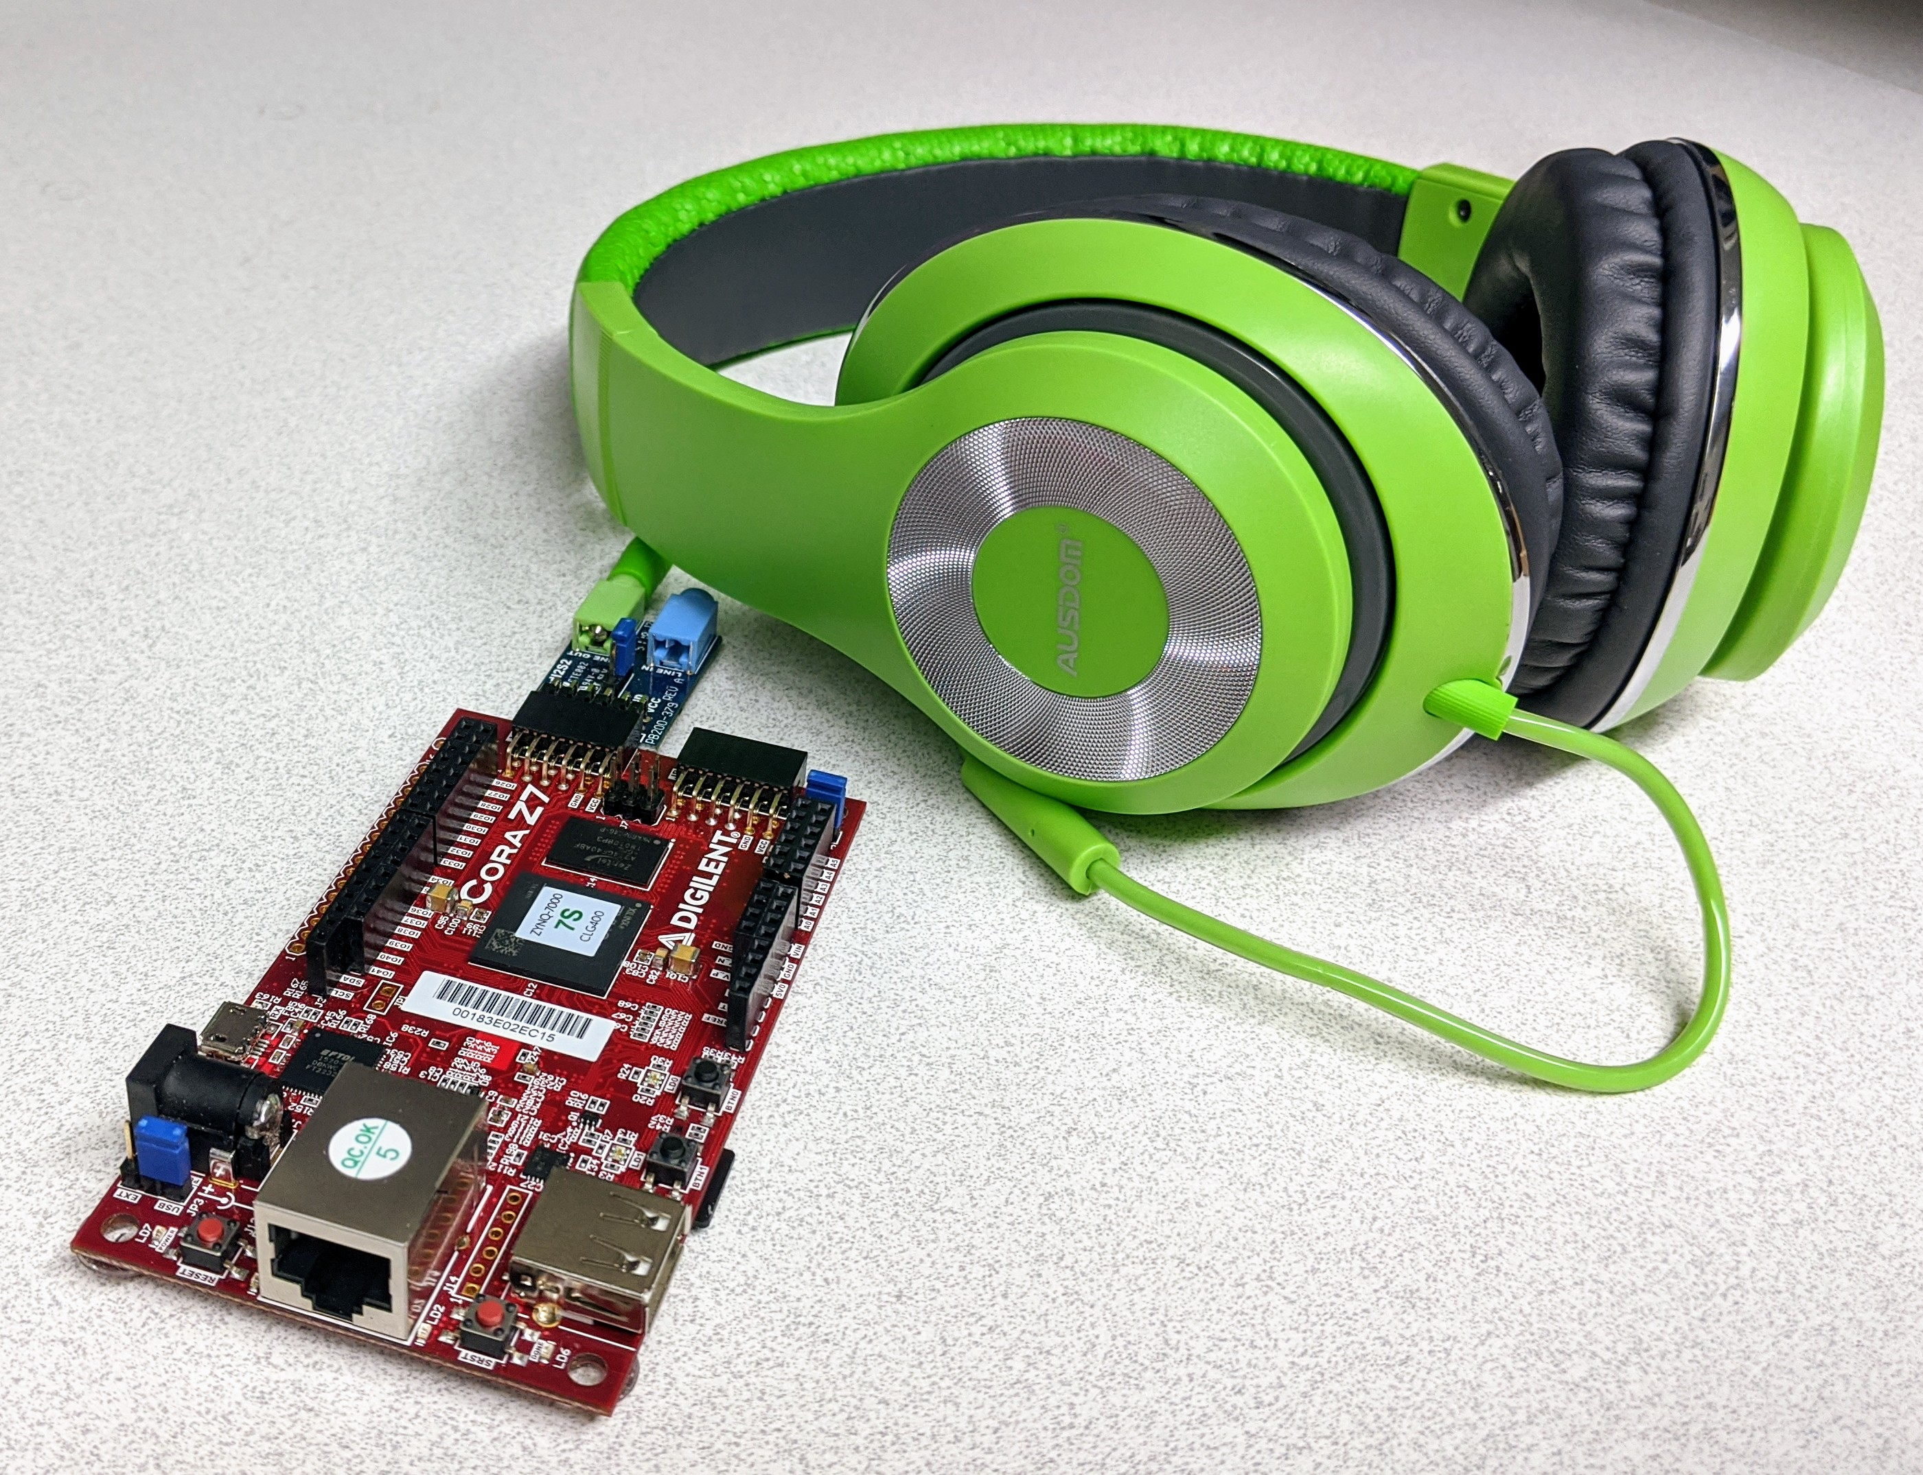
Example Competition
Your team is tasked with designing a secure Digital Rights Management (DRM) module to be used on next generation multimedia player devices
The prototype music player is called…​
…the miPod!
Notes:
DRM is sometimes a contentious topic that people have strong opinions about. Might want to make a point to say that this scenario should not be taken as an indication of our stance on whether or not DRM is a good thing in the world. We simply think that it creates for a very challenging and interesting security scenario.

Slide 5
Why do the eCTF?
Unparalleled hands-on experience
Crypto/protocol design
Low-level C programming
Real-world offensive security
Project management
Career advancement
Looks great on a resume
Massive talent supply shortage in embedded security
It’s fun! (but a lot of work)

Slide 6
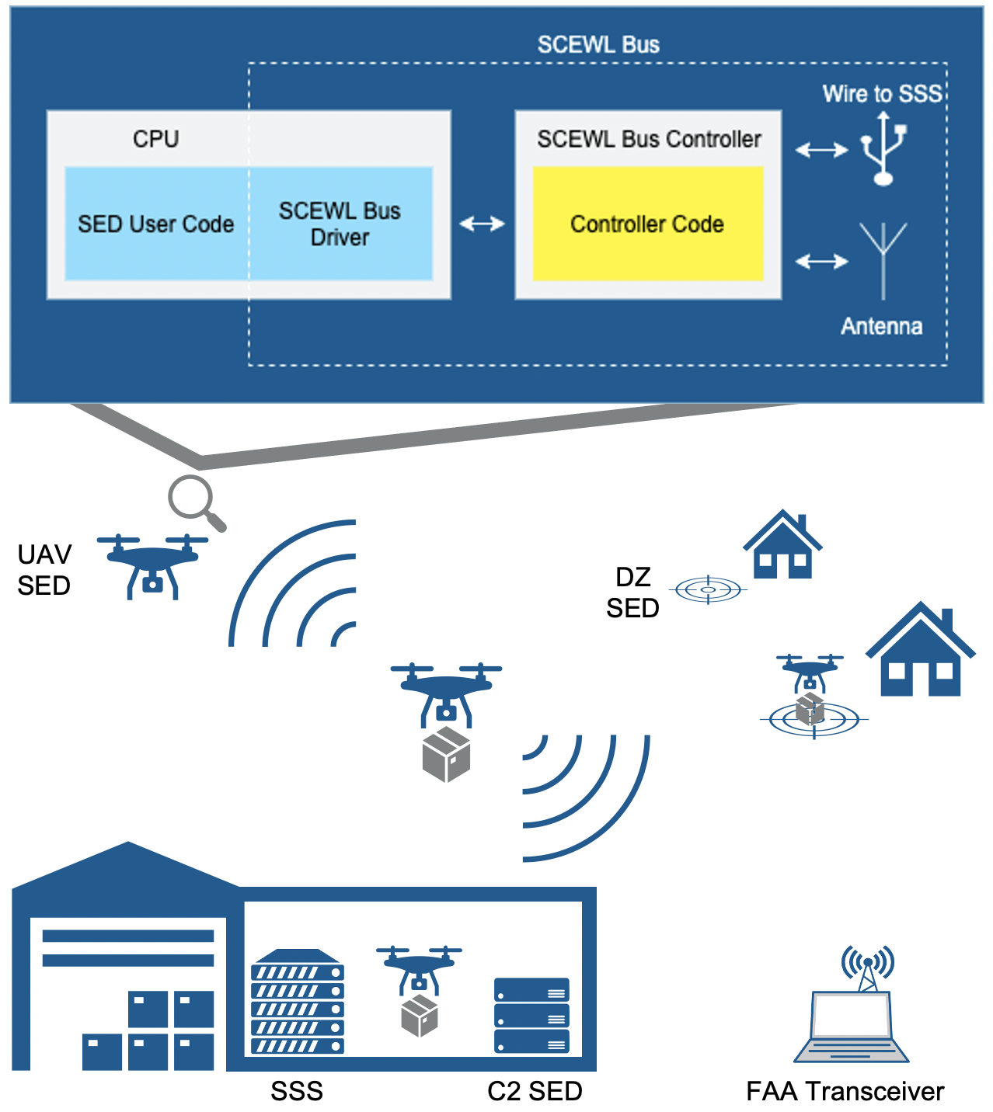
2021 Competition

Slide 7
What is Side-Channel?

Slide 8

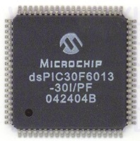
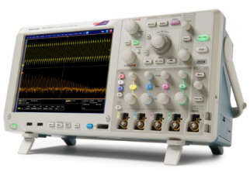
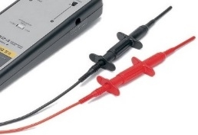
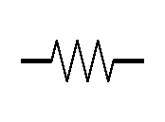
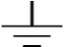
Side-Channel Analogy
Combo
Crypto Keys
Acoustic Side-Channel
Power Side-Channel
Side-channel analysis (SCA) leverage unavoidable side-effects of performing computation

Slide 9
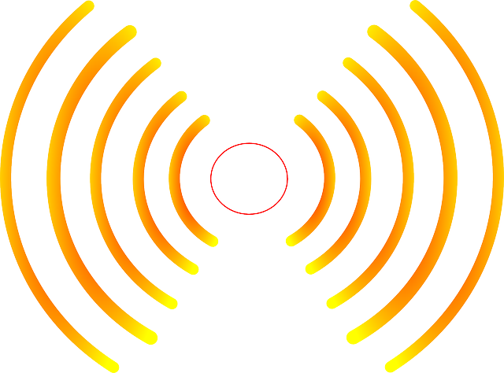

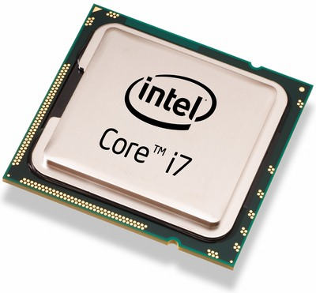

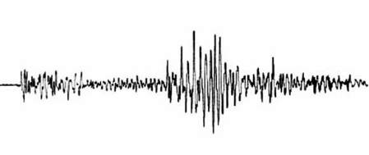
Side-Channel Attacks
SCA commonly used to:
Reverse engineer system operation
Extract information (e.g., keys)
Monitor and validate system behavior
EM Radiation
Thermal
Execution Time
Instantaneous Power
http://www.itp.net/573498-intel-core-i7-920
https://www.kisspng.com/png-light-electromagnetic-spectrum-electromagnetic-rad-1233022/
Acoustic Vibrations
https://pixabay.com/en/thermometer-temperature-rainbow-305319/
https://commons.wikimedia.org/wiki/File:Dtjohnnymonkey-Stopwatch-no-shading.svg
https://commons.wikimedia.org/wiki/File:1989_Loma_Prieta_earthquake_seismogram.jpg

Slide 10
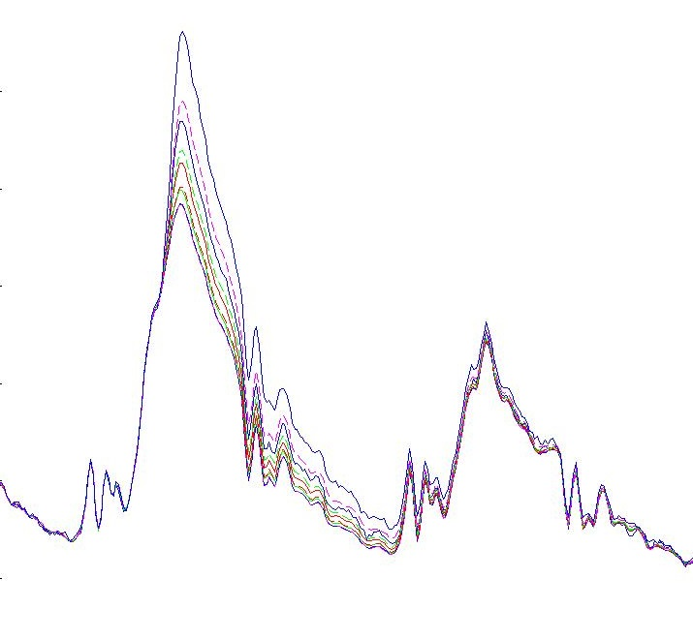
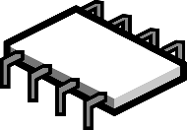
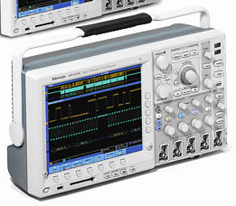
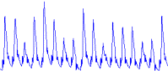

Side-Channel Capture
Side-channel leakage is captured during normal device operation
Target device is instrumented with sensors (e.g., current monitor)
Device commanded to perform its sensitive operation
Captured side-channel data is stored along with the corresponding inputs and outputs
Data-dependent power consumption
Data
Power Consumption
Photo: Tektronix Inc.
Time
Chip Image Source: https://pixabay.com/en/microchip-component-computer-chip-309407/
Battery Image Source: Tango Desktop Project
© 2018 MITRE Corporation

Slide 11
Side-Channel Workshop
https://mybinder.org/v1/gh/janisbent/sc-lab/v1.0?filepath=%2FSide_Channel_Lab.ipynb

Slide 12
Ben Janis
btjanis@mitre.org
linkedin.com/in/benjanis

